Slide 1
Quantifying Technical Debt
Nick Fahrig – Principal Software Engineer at Insight

Slide 2







Cincy Deliver 2023 Sponsors
Diamond
Platinum
Gold
Silver
Community

Slide 3
Quantifying Technical Debt
What is technical debt?
How does it happen?
Why is it a problem?
How do you quantify the debt?
How do we pay off the debt?

Slide 4
What is Technical Debt?
“Technical Debt is a metaphor for shortcuts and hacks in software that make it more difficult to change and maintain than it could be with an optimal design”
- Steve Smith, Ardalis

Slide 5
What is Technical Debt?
Poor software design that gets in the way of making changes and maintaining.
Technical debt is a metaphor that equates software development to financial debt.
Debt has two components
Principal debt – the effort needed to “pay off” the debt
Interest – the effort added to updating and maintaining the code

Slide 6
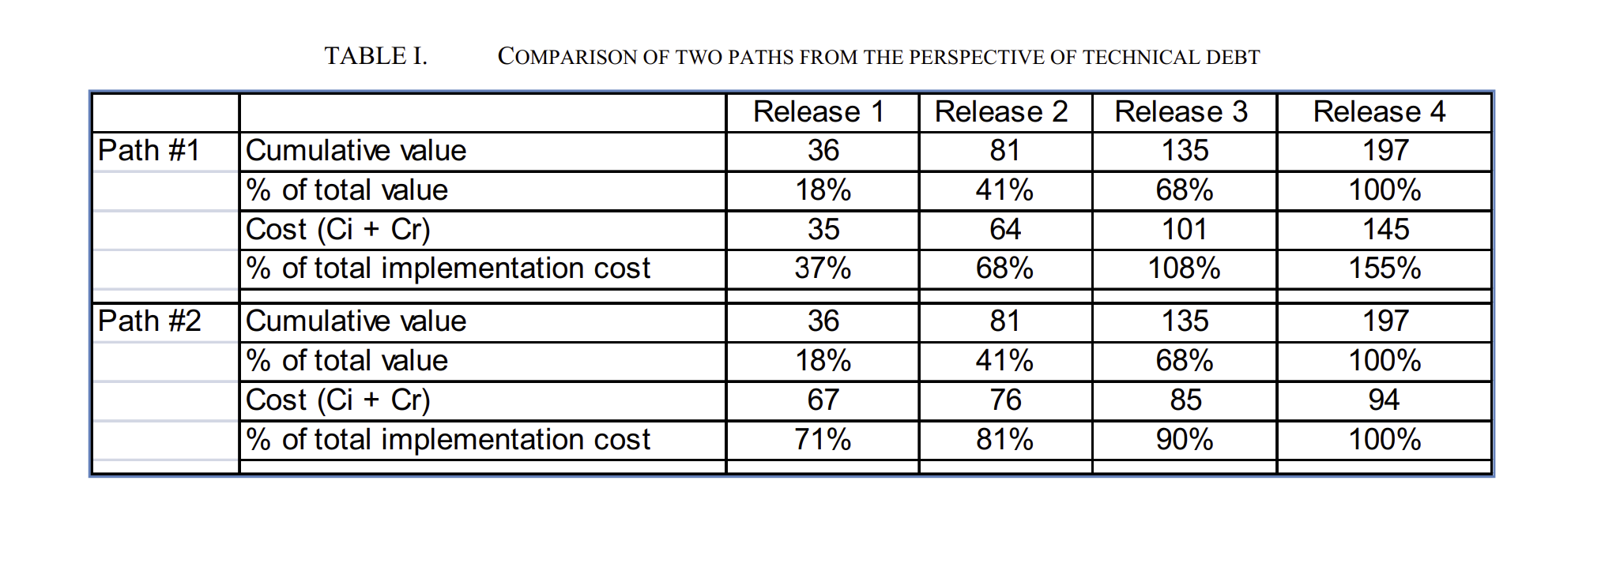
Cost = Time
Technical debt “borrows” time from the future to release something quicker.
From “In Search of a Metric for Managing Architectural Technical Debt”

Slide 7
How does it happen?

Slide 8
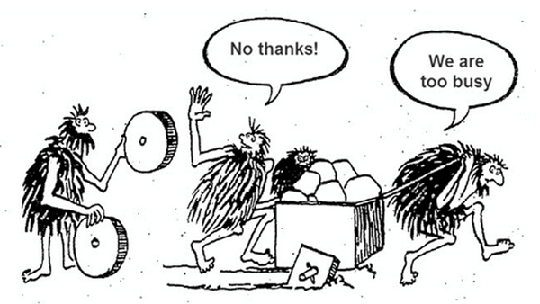

Slide 9
Technical Debt Quadrants
Reckless, Deliberate
Prudent, Deliberate
Conscious choice to make “quick and dirty” updates in exchange for speed.
Conscious choice to take on debt for a deadline
Team recognizes the issue, adding stories to the backlog to revisit.
Reckless, Accidental
Prudent, Accidental
Not recognizing poor design choices
Recognizing a better design after finishing a task
Team gains improved understanding

Slide 10
Why is it a problem?

Slide 11

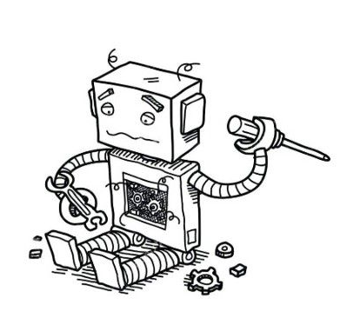
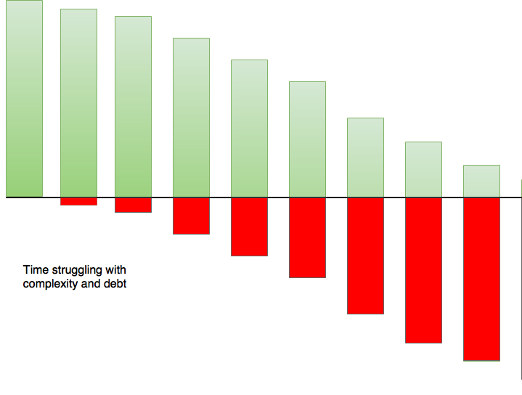
Why is it a problem?
Reduced efficiency
Increased pain
Poor user experience
Time spent on deciphering code and clearing blockers
Easier for bugs to appear, harder to test
Degraded performance

Slide 12
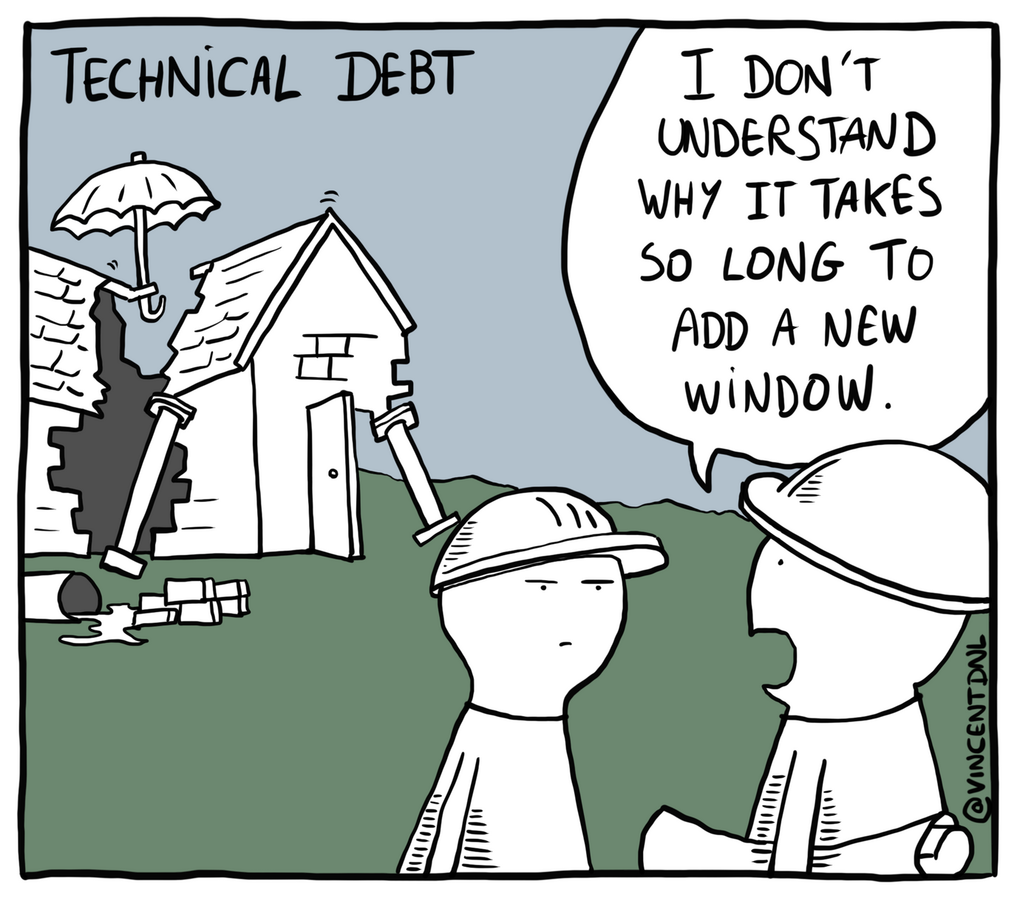

Slide 13
How do you quantify the debt?

Slide 14
Architectural Debt - In Search of a Metric for Managing Architectural Technical Debt
This approach relies on having a clear picture of the existing architecture.
Robert Nord breaks down calculating the cost of implementing an architecture into 2 parts
The implementation cost is the effort to implement each new element.
The rework cost is the effort involved to update existing elements whenever a new element is added.
That rework cost represents the technical debt.

Slide 15
Re-work calculation
Calculating the rework necessary when each new element is added is based on three separate items.
The dependencies between the existing element and new element
The original implementation cost of the existing element
The change needed to existing elements to function alongside the new element.
The larger each item is, the larger the rework cost will be.
Using this is examine an architectural design can be helpful to determine when its time to pay off any architectural technical debt.

Slide 16
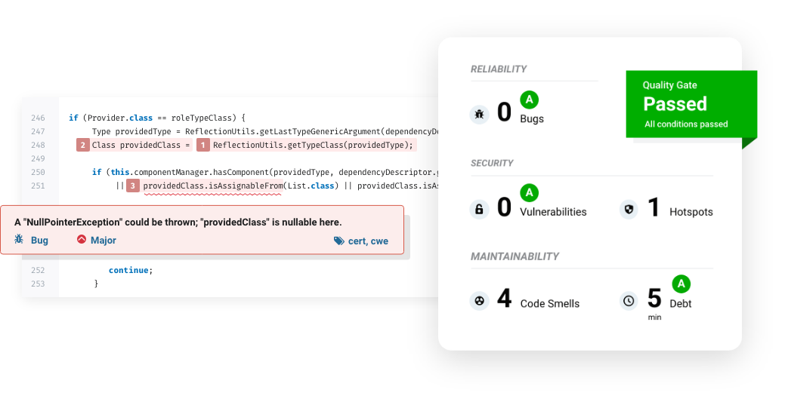
Quantifying Code Debt with Tooling
SonarQube - Static code analyzer focused on code quality
Works with 29 different programming languanges
CI/CD integration

Slide 17
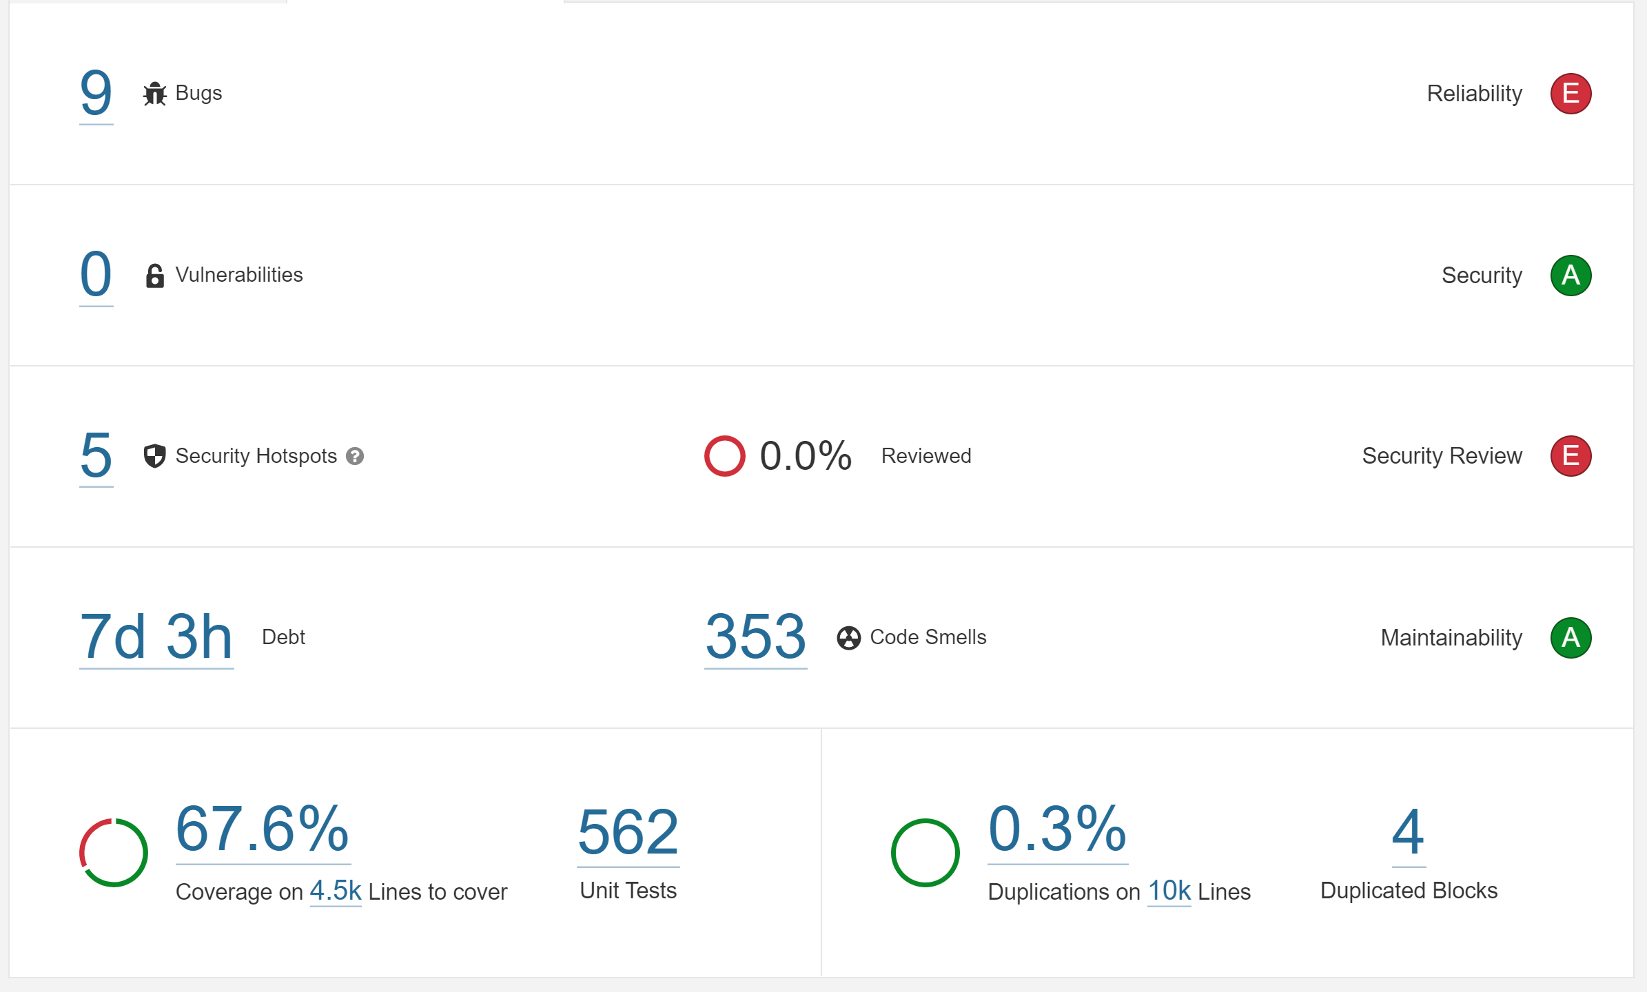
SonarQube
Very good at quantifying the total “principal” debt left to be paid

Slide 18
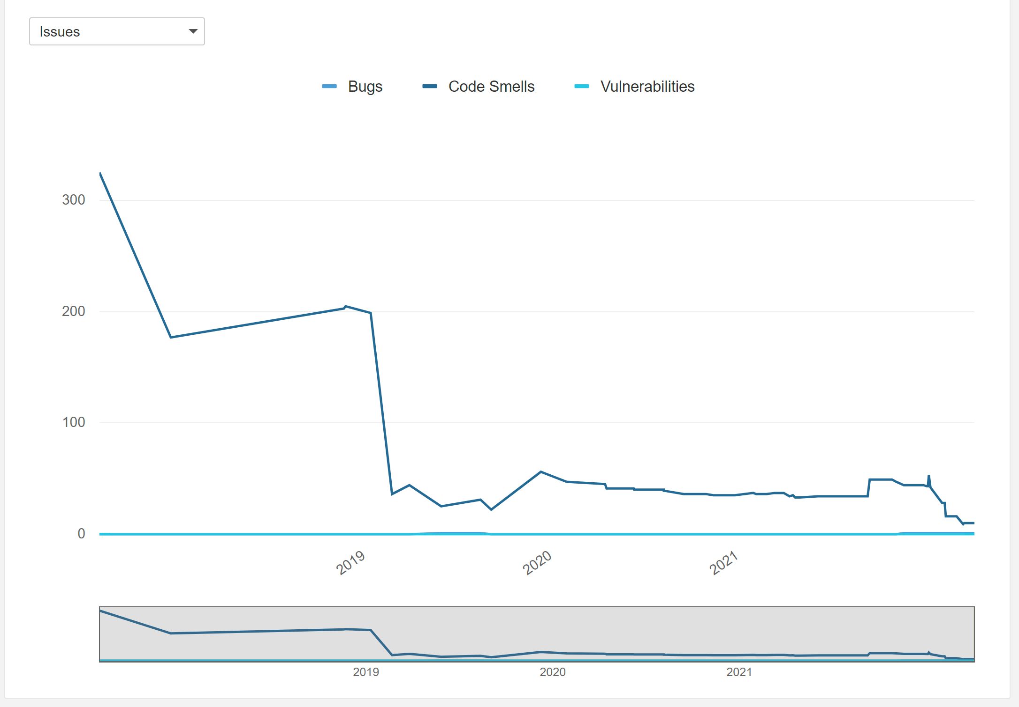
SonarQube

Slide 19
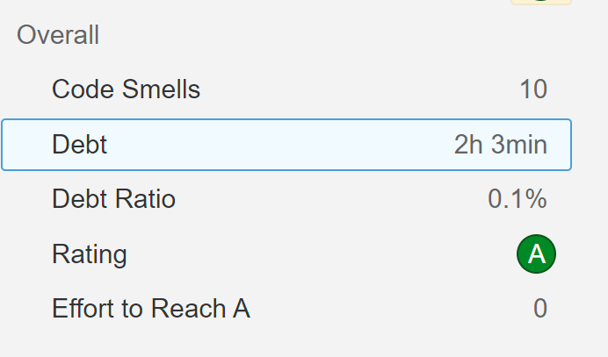
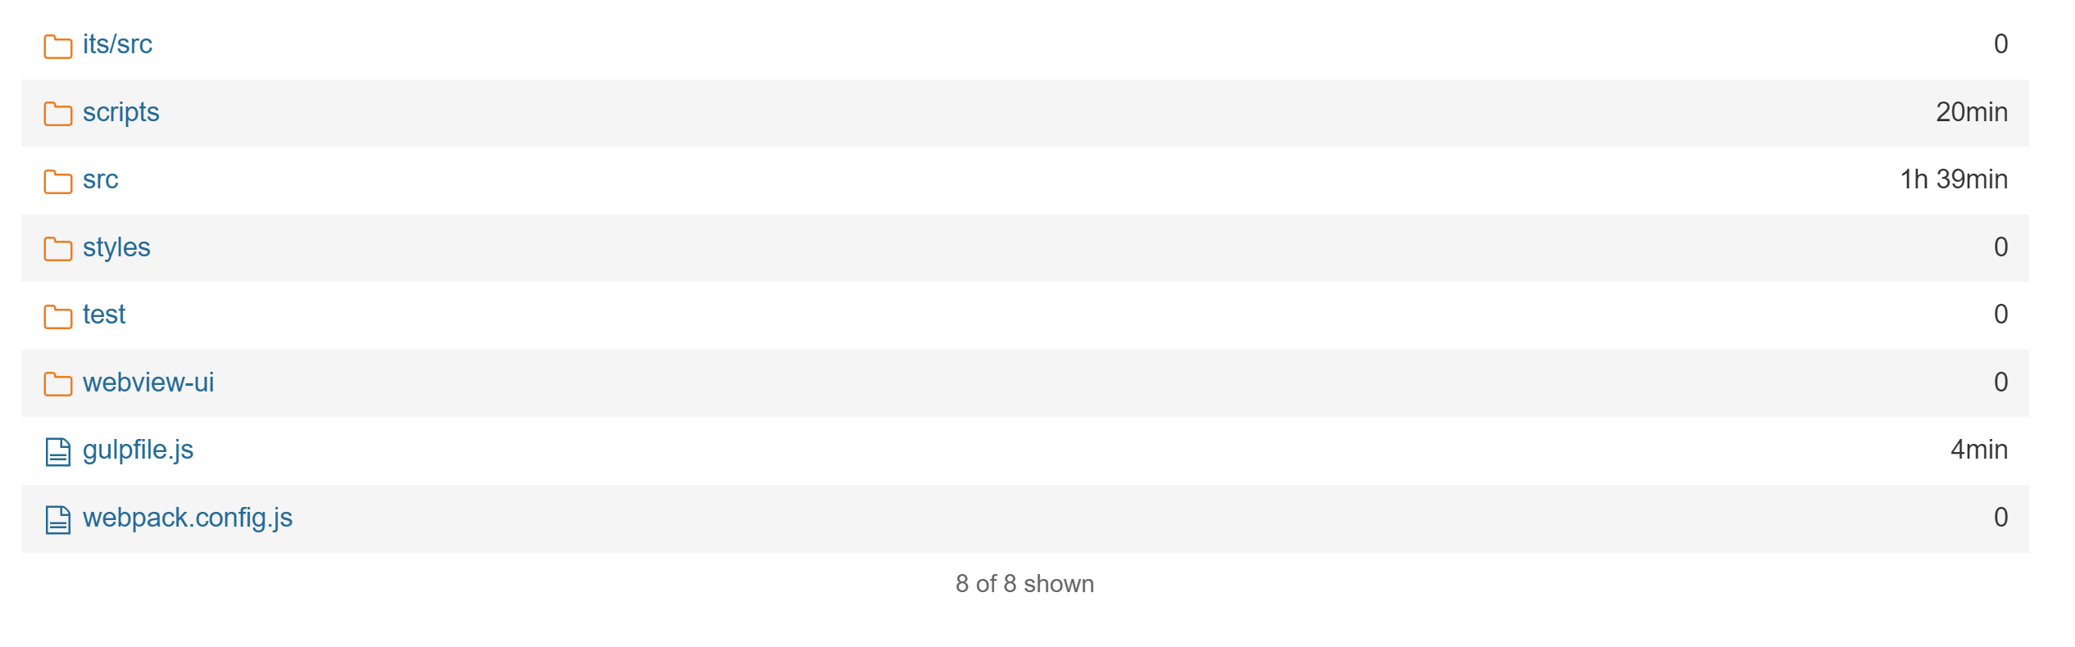
SonarQube
Can identify what parts of the application have the most debt

Slide 20
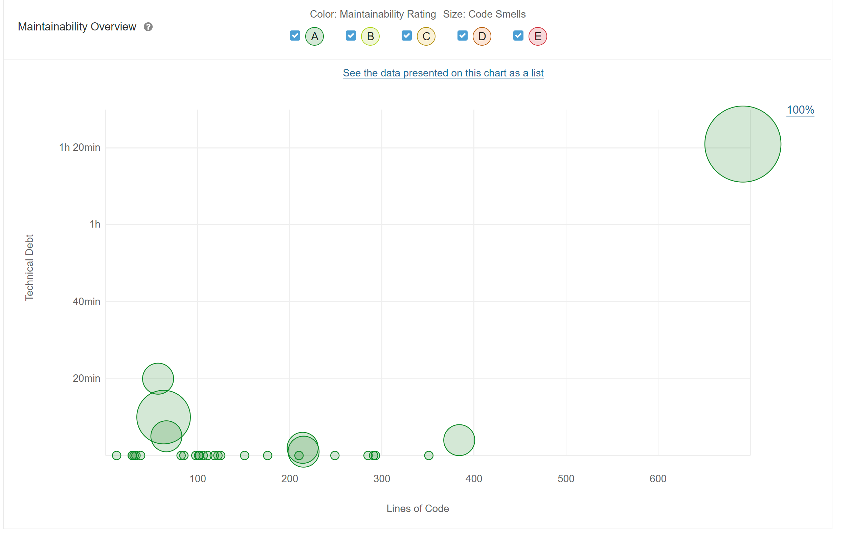
SonarQube

Slide 21
How do we pay off the debt?

Slide 22
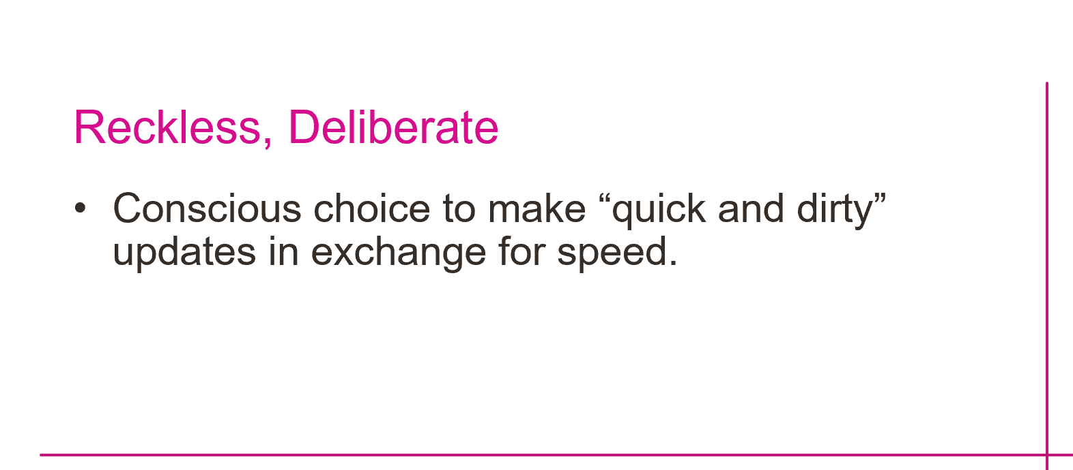
For the Agilists
If you notice the team is often doing “quick and dirty” work, ask the questions:
“Is the team feeling too much pressure?”
“Is morale low on the team?”
“Is the team frustrated that their ideas aren’t well received?”

Slide 23
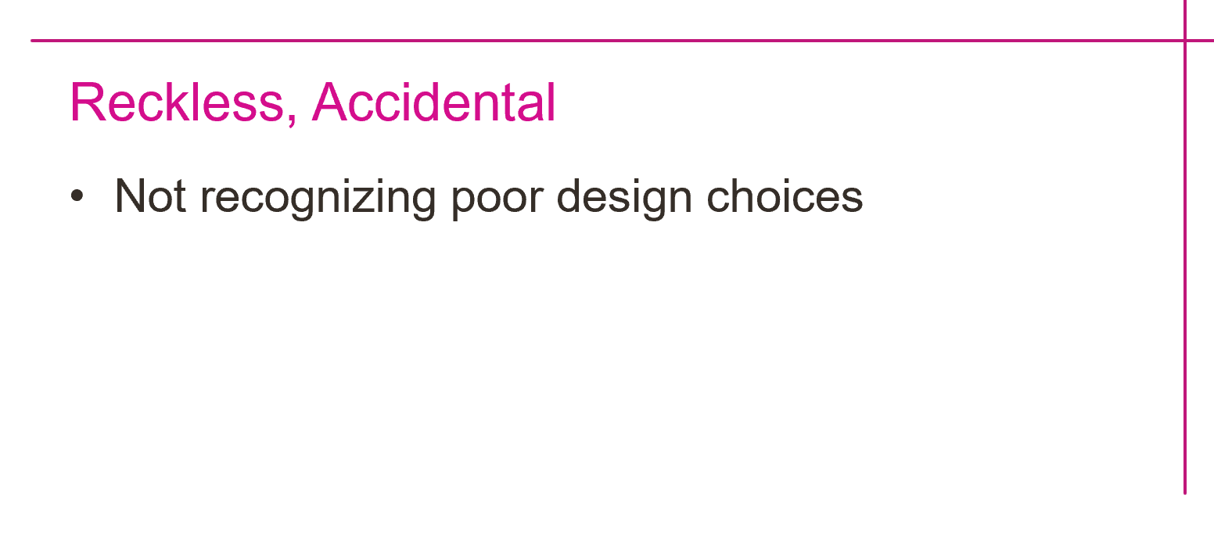
For the Agilists
If you notice the team introducing debt due to a lack of knowledge, ask the questions:
“Do we have the right people on the team?”
“Is it knowledge on the product or technical that seems lacking?”
“Should we encourage teammates to do some training?”

Slide 24
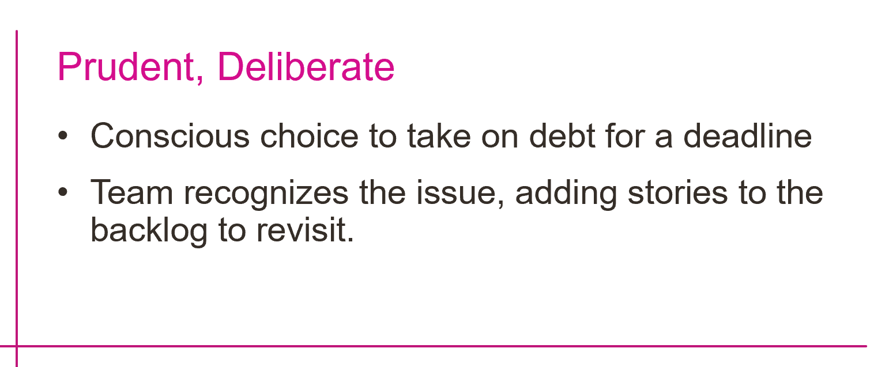
For the Agilists
If you notice the team making design choices based on speed, Ask the questions:
“If time wasn’t an issue, what would be the right way to solve the (feature/user story/ task)?”
“Should we add a story to represent that approach, so we can revisit once we don’t have an approaching deadline / milestone?”

Slide 25
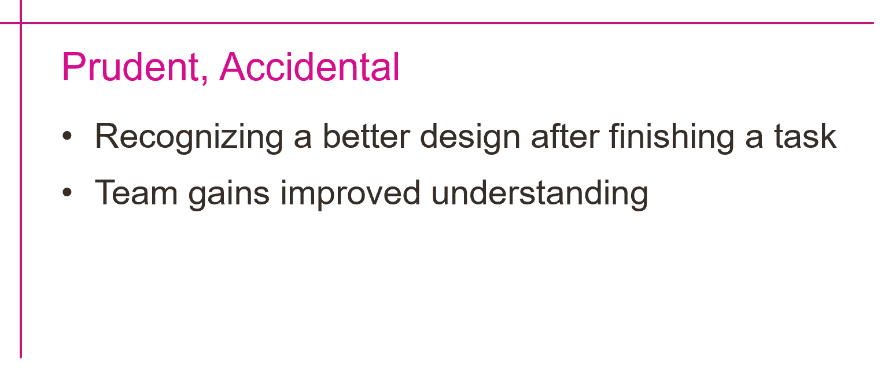
For the Agilists
If you notice the team realizing a better design after completing work, Ask the questions:
“What lessons did we learn?”
“Can we make a note of what we should have done differently so we can plan better the next time?”

Slide 26
For the Developers
Refactor while adding value
Stop the bleeding
Dedicate user stories
Paying more than the minimum payment.
When fixing a bug or updating existing functionality – take some extra time to clean up the code around your changes.
Cut up the credit cards approach
Adopt standards that all new code will follow
Maintain legacy code by adding new code
Make new classes that can be well tested and not tightly coupled
Update old code to make use of the new class
Make extra monthly payments
Easiest to do when the team made the prudent and deliberate choice to take on debt.

Slide 27
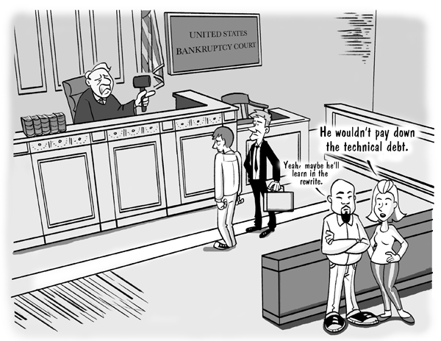
Declare Bankruptcy

Slide 28
Cincy Deliver 2023 Sponsors
Diamond
Platinum
Gold
Silver
Community

Slide 29
links
SonarQube - https://www.sonarqube.org/
SonarCloud - https://www.sonarsource.com/products/sonarcloud/
cloud based version of SonarQube
References
Attacking Technical Debt | Blog (ardalis.com)
TechnicalDebtQuadrant (martinfowler.com)
In Search of a Metric for Managing Architectural Technical Debt (cmu.edu)

Slide 30
Questions for addressing Technical Debt
If you notice the team is often doing “quick and dirty” work, ask the questions:
“Is the team feeling too much pressure?”
“Is morale low on the team?”
“Is the team frustrated that their ideas aren’t well received?”
If you notice the team introducing debt due to a lack of knowledge, ask the questions:
“Do we have the right people on the team?”
“Is it knowledge on the product or technical that seems lacking?”
“Should we encourage teammates to do some training?”
If you notice the team making design choices based on speed, Ask the questions:
“If time wasn’t an issue, what would be the right way to solve the (feature/user story/ task)?”
“Should we add a story to represent that approach, so we can revisit once we don’t have an approaching deadline / milestone?”
If you notice the team realizing a better design after completing work, Ask the questions:
“What lessons did we learn?”
“Can we make a note of what we should have done differently so we can plan better the next time?”

Slide 31
Thanks for joining!

